Slide 1
Graduate Computer Architecture I
Lecture 14: Network Processor

Slide 2
Network Processor
Terminology emerged in the industry 1997-1998
  Many startups competing for the network building-block
  Broad variety of products are presented as an NP
Function
  Integration and programmability
  Efficient processing of network headers in packets
  Support for higher-level flow management
Wide spectrum of capabilities and target markets

Slide 3
Motivation
“Flexibility of a fully programmable processor with performance approaching that of a custom ASIC.”
  Faster time to market (no ASIC lead time)
  Instead you get software development time
Field upgradability leading to longer lifetime
  Ability to adapt deployed equipment to evolving and emerging standards and new application spaces
  Enables multiple products using common hardware
Allows the network equipment vendors to focus on their value-add

Slide 4
Usage
Integrated GPP + system controller + “acceleration”
Fast forwarding engine with access to a “slow-path” control agent
A smart DMA engine
An intelligent NIC
A highly integrated set of components to replace a bunch of ASICs and the blade control uP

Slide 5
Features
Integrated or attached GPP
Pool of multithreaded forwarding engines
High Bandwidth and High Capacity Mems
  Embedded and external SRAM and DRAM
Variety of Communication mediums
  Integrated media interface or media bus
  Interface to a switching fabric or backplane
  Interface to a “host” control processor
  Interface to coprocessors

Slide 6
Result
Higher Performance
  Specialized network processing engines
  Multiple processing elements
  Low Latency
Intelligence
  Network level without going to main processor
Modularity
  Taking the processing load off GPP
  NP handles the network
  GPP handles the application

Slide 7
NP Architectural Challenges
Application-specific architecture
  Yet, covering a very broad space with varied (and ill-defined) requirements and no useful benchmarks
  Need to understand the environment
  Need to understand network protocols
  Need to understand networking applications
Have to provide solutions before the actual problem is defined
  Decompose into the things you can know
  Flows, bandwidths, “Life-of-Packet” scenarios, specific common functions

Slide 8
Network Application Partitioning
Network Processing Plane
  Forwarding Plane: Data movement, protocol conversion, etc
  Control Plane: Flow management, (de)fragmentation, protocol stacks and signaling stacks, statistics gathering, management interface, routing protocols, spanning tree etc.
Control Plane
  Divided into Connection and Management Planes
  Connections/second is a driving metric
  Often connection management is handled closer to the data plane to improve performance-critical connection setup/teardown
  Control processing is often distributed and hierarchical

Slide 9
Simplified Categorization of Applications
Payload Inspection
Real Time
Virus Scanning
TCP Header
Virtual Private Network
Firewall
Packet Inspection Complexity
Application Processing Complexity
IP Header
Load Balancing
Ethernet
Header
Network Monitoring
Quality of Service
Routing
Switching

Slide 10
Application
Forwarding (bridging/routing)
Protocol Conversion
In-system data movement (DMA+)
Encapsulation/Decapsulation to fabric/backplane/custom devices
Cell/packet conversion (SAR’ing)
L4-L7 applications; content and/or flow-based
Security and Traffic Engineering
  Firewall, Encryption (IPSEC, SSL), Compression
  Rate shaping, QoS/CoS
Intrusion Detection (IDS) and RMON
  Particularly challenging due to processing many state elements in parallel, unlike most other networking apps which are more likely single-path per packet/cell

Slide 11
NP Application Challenges for NPs
Infinitely variable problem space
“Wire speed”; small time budgets per cell/packet
Poor memory utilization; fragments, singles
  Mismatched to burst-oriented memory
Poor locality, sparse access patterns, indirections
  Memory latency dominates processing time
  New data, new descriptor per cell/packet. Caches don’t help
  Hash lookups and P-trie searches cascade indirections
Random alignments due to encapsulation
  14-byte Ethernet headers, 5-byte ATM headers, etc.
  Want to process multiple bytes/cycle
High rate of Special Cases
  Short-lived flows (esp. HTTP)
  Sequential requirements within flows; sequencing overhead/locks

Slide 12
Acceleration Techniques (1)
Offload high-touch portions of applications from the uP
  Header parsing, checksums/CRCs, RegEx string search
Offload latency-intensive portions to reduce uP stall time
  Pointer-chasing in hash table lookups, tree traversals for e.g. routing LPM lookups, fetching of entire packet for high-touch work, fetch of candidate portion of packet for header parsing
Offload compute-intensive portions with specialized engines
  Crypto computation, RegEx string search computation, ATM CRC, packet classification (RegEx is mainly bandwidth and stall-intensive)
Provide efficient system management
  Buffer management, descriptor management, communications among units, timers, queues, freelists, etc.

Slide 13
Acceleration Techniques (2)
Media processing (framing etc)
  Specialized units
Decouple hard real-time from budgeted-time
  meet per-packet/cell time budgets
  higher level processing via buffering (e.g. IP frag reass’y, TCP stream assembly and processing etc.)
Efficient communication among units
  Hardware and software must be well architected and designed to avoid this.
  Keep compute:communicate ratio high.

Slide 14
Acceleration via Pipelining
Goal is to increase total processing time per packet/cell by providing a chain of pipelined processing units
  May be specialized hardware functions
  May be flexible programmable elements
  Might be lockstep or elastic pipeline
  Communication costs between units must be minimized to ensure a compute:communicate ratio that makes the extra stages a win
  Possible to hide some memory latency by having a predecessor request data for a successor in the pipeline
  If a successor can modify memory state seen by a predecessor then there is a “time-skew” consistency problem that must be addressed

Slide 15
Acceleration via Parallelism
Goal is to increase total processing time per packet/cell by providing several processing units in parallel
  Generally these are identical programmable units
  May be symmetric (same program/microcode) or asymmetric
  If asymmetric, an early stage disaggregates different packet types to the appropriate type of unit (visualize a pipeline stage before a parallel farm)
  Keeping packets ordered within the same flow is a challenge
  Dealing with shared state among parallel units requires some form of locking and/or sequential consistency control which can eat some of the benefit of parallelism
Caveat; more parallel activity increases memory contention, thus latency

Slide 16
Latency Hiding via Hardware Multi-Threading
Goal is to increase utilization of a hardware unit by sharing most of the unit, replicating some thread state, and switching to processing a different packet on a different thread while waiting for memory
  Specialized case of parallel processing, with less hardware
  Good utilization is under programmer control
  Generally non-preemptable (explicit yield model instead)
  As the ratio of memory latency to clock rate increases, more threads are needed to achieve the same utilization
  Has all of the consistency challenges of parallelism plus a few more (e.g. spinlock hazards)
  Opportunity for quick state sharing thread-to-thread, potentially enabling software pipelining within a group of threads on the same engine (threads may be asymmetric)

Slide 17
Coprocessors: NP’s for NP’s
Sometimes specialized hardware is the best way to get the required speed for certain functions
  Many NP’s provide a fast path to external coproc’s; sometimes slave devices, sometime masters.
Variety of functions
  Encryption and Key Management
  Lookups, CAMs, Ternary CAMs
  Classification
  RegEx string searches (often on reassembled frames)
  Statistics gathering

Slide 18
A Typical NP Architecture
Physical
Interface
Network
DMA/Buffer
General
Purpose
Processor
Coproc
Interface
Network
(i.e. GbE)
Internal BUS
Memory
Memory
Interface
DMA/BUS
Interface
Coproc
To main BUS (i.e. PCI-X)

Slide 19
Myricom LANai
Processor on Myrinet NIC
  Leading Interface card for Clustering
  Offload Network processing from main Processor
  One of the first “Network Processor”
Pipelined RISC processor
  General Purpose Processor
  Fully functional GCC with libraries
Interfaces
  Network (Myrinet – High BW/Low Latency)
  SRAM Memory Interface
  BUS Interface

Slide 20
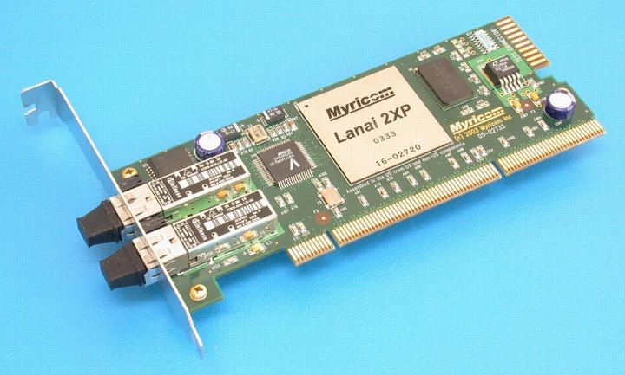
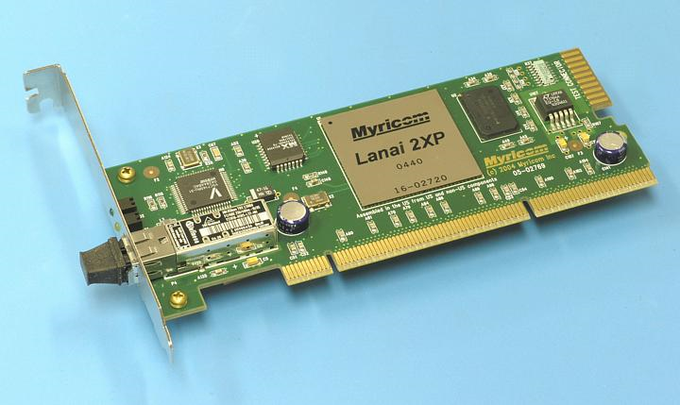
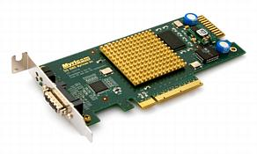
Myrinet Cards

Slide 21
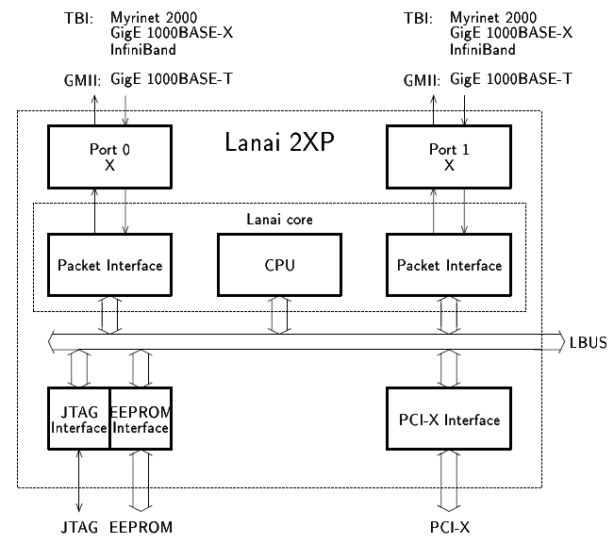
LANai 2XP

Slide 22
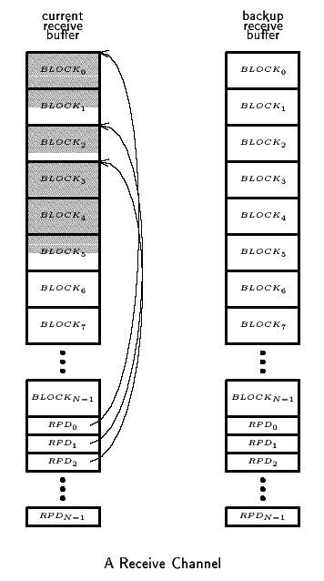
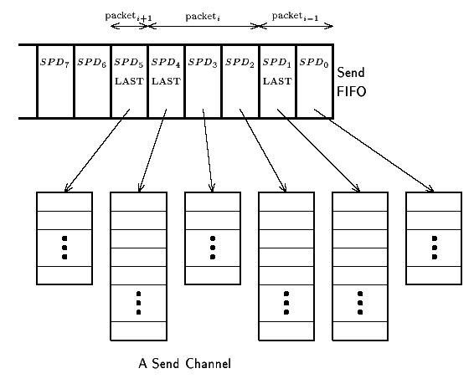
Packet Receive/Send Interface

Slide 23
Characteristics
Physical Links are 10-Gigabit Ethernet
  XAUI, per IEEE 802.3ae
  10+10 Gigabits per second, full-duplex.
  XAUI is readily converted to other 10-Gigabit Ethernet PHYs.
  At the Data-Link level, the links may be either Ethernet or Myrinet
Software support is Myrinet Express (MX)
  MX-10G is the low-level message-passing system for the Myri-10G products.
  MX-2G for Myrinet-2000 PCI-X NICs is available now.
  Includes ethernet emulation (TCP/IP, UDP/IP)
  10-Gigabit Ethernet operation is based on MX ethernet emulation
Performance with the initial Myri-10G PCI-Express NICs
  Myrinet mode: 2µs MPI latency with 1.2 GBytes/s one-way
  10-Gigabit Ethernet mode, 9.6 Gbits/s TCP/IP rate

Slide 24
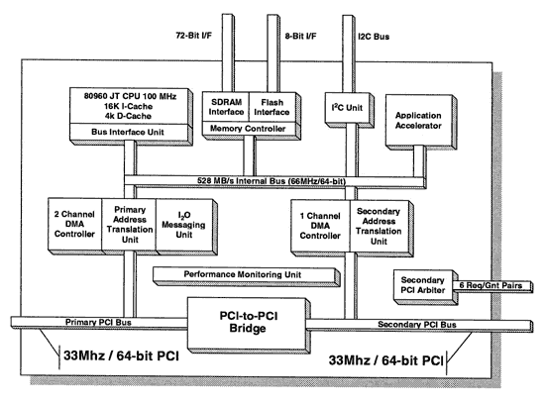
Intel i960

Slide 25
Intel i960
Embedded Processor
  I/O Processor
  Peer-to-peer
  Network Processor
PCI Interface
  One to the Main BUS
  Other to the Network Interface
Similar to Myrinet LANai
Further development leading into IXA?

Slide 26
Intel IXA
Current Routers
  Involve general purpose CPUs
  Lots of ASICs (Application Specific Integrated Circuits ).
  The ASICs are necessary to keep up with the quantity and rate of the network traffic.
The StrongARM Core
  Replace the general purpose CPUs
Microengines
  Replace the bulk of the ASICs
Actually inherited IXA when they bought Digital.

Slide 27
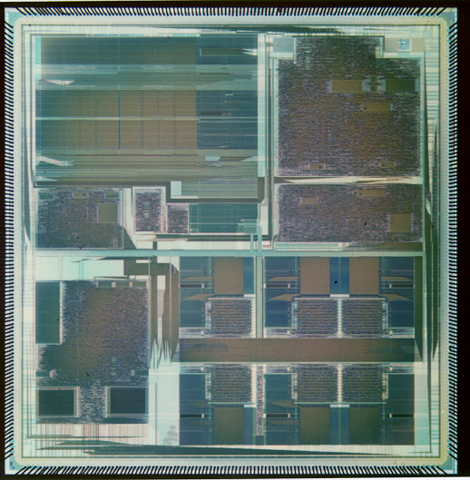
Intel IXP1200 NP
StrongARM Core
PCI
Very Low Power Parallel Processor Architecture with 7 232 MHz RISC processors
Hardware Based Multithreading on 6 RISC engines - Cost Effective
Distributed Data Storage Arch Supports Very Simple Programming Model
Active Memory Optimizations - High Performance With Commodity RAMs
Scalable Architecture
PCI
SRAM
SRAM
SDRAM
SDRAM
IX Bus
IX Bus
6 RISC Engines
Notes:
This foil highlights the features of the IXP1200 which also exist in the IXP1240 and IXP1250 NPs
The wide range of packet handling and control functionality integrated into the IXP1200 Network Processor enables equipment developers to focus on development of new features and services

Slide 28
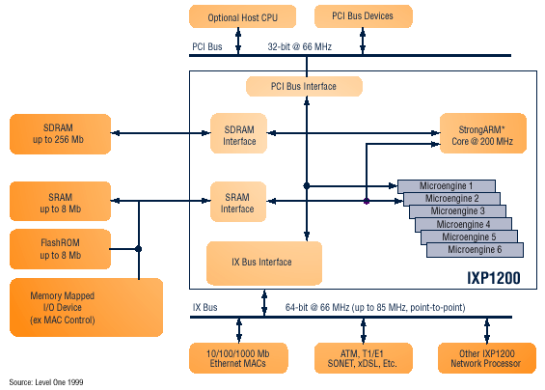
Intel IXP 1200 Block Diagram

Slide 29
IXP2400 Features
Host
CPU
(Optional)
Interface supports UTOPIA 1/2/3, SPI-3 (POS-PL3), and CSIX.
Four independent, configurable, 8-bit channels with the ability to aggregate channels for wider interfaces.
Media interface can support channelized media on RX and 32-bit connect to Switch Fabric over SPI-3 on TX (and vice versa) to support Switch Fabric option.
Two Quad Data Rate SRAM channels.
A QDR SRAM channel can interface to Co-Processors.
One DDR DRAM channel.
PCI 64/66 Host CPU interface.
Flash and PHY Mgmt interface.
Dedicated inter-IXP channel to communicate fabric flow control information from egress to ingress for dual chip solution.
Classification Accelerator
QDR SRAM
20 Gbps
32 M Byte
IXP2400
(Receive)
DDR DRAM
2 GByte
Micro-Engine
Cluster
Customer ASICs
IXP2400
(Transmit)
Flash
Utopia 1/2/3 or
POS-PL2/3
Interface
Switch Fabric Port Interface
ATM / POS PHY
or Ethernet MAC

Slide 30
Microengine V2
From Next Neighbor
D-Push Bus
S-Push Bus
Control
Store
4K
Instructions
Local
Memory
128
GPR
128
GPR
128 Next
Neighbor
128 D
Xfer In
128 S
Xfer In
LM Addr 1
2 per CTX
LM Addr 0
P-Random #
A_Operand
B_Operand
CRC Unit
CAM
Multiply
Execution
Data path
CRC remain
Find first bit
Local
CSRs
Add, shift, logical
ALU_Out
To Next Neighbor
128 D
Xfer Out
128 S
Xfer Out
D-Pull Bus
S-Pull Bus

Slide 31
IXP 2400
Eight next generation Microengines (MEv2)
  Operating at 600MHz
  Automated packet scheduling and handling
  Local data store enables higher performance
Hardware acceleration for DiffServ, MPLS, and other QoS schemes
ATM Segmentation and Reassembly (SAR) support with headroom.
Intel® XscaleTM microarchitecture core operating at 600MHz

Slide 32
Summary
There are no typical applications
  Many variety of applications
Network processing solution partitions
  Forwarding plane
  Connection management plane
  Control plane
GPP with Application Specific Components
  Higher data rates and complex applications
  More specific to the application to beat GPP

